Slide 1
Predictive analyisis for stockmarket forecasting
Swipe

Slide 2
@saiby sani18
Problem Objective
Objective:
To develop a predictive model that forecasts the closing stock price of a company over a weekly time frame. The model will leverage historical stock prices, trading volumes, and financial metrics (e.g., P/E Ratio) to help investors or analysts make informed decisions about future price movements.

Slide 3
@saiby sani18
This project aims to forecast the stock market trends for Intel and AMD by leveraging weekly data to capture long-term dependencies. By analyzing historical closing prices, trading volumes, and financial metrics like P/E Ratio, the goal is to build a predictive model that identifies patterns and trends influencing stock prices over weeks and months. The focus on long-term forecasting provides valuable insights for investors and analysts planning broader strategies, while the comparative analysis of Intel and AMD offers a deeper understanding of their performance dynamics and market behavior.

Slide 4
3. Mention the Data
I Collected the data from kaggle source which is the stocks of intel and amd campanies which contains the stock prices from 2004 to 2014

Slide 5
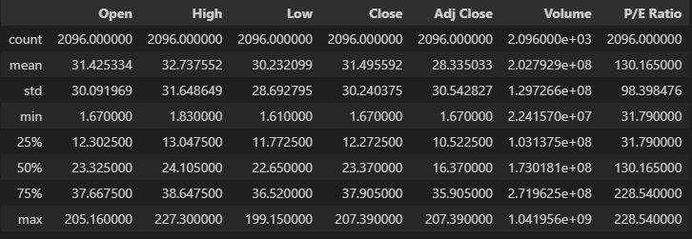
statistcal summary of data

Slide 6
@saiby sani18
TOOLS & TECHNIQUES
Tools:
Streamlit
Matplotlib
Pandas
Tensorflow-LSTM
keras

Slide 7
Normalization: Scaled data to 0-1 for better LSTM performance.
LSTM Model: Captured time-series patterns with sequential layers.
Dropout: Reduced overfitting.
Adam Optimizer & MSE Loss: Efficient training and error minimization.
Early Stopping: Avoided overtraining by monitoring validation loss.

Slide 8
5. Discussing the Process

Slide 9
@saiby sani18
Project Process in Brief
Data Collection: Gathered stock market data for Intel and AMD.
Preprocessing: Cleaned, normalized, and prepared the data for modeling.
Sequence Generation: Created time-step sequences to capture temporal patterns.
Model Development: Built an LSTM model with dropout layers to handle overfitting.
Model Training: Trained the model on historical data and validated its performance.
Evaluation: Assessed accuracy using metrics like R² and visualized predictions.
Dashboard Creation: Designed a user-friendly interface for data upload and predictions.
Business Insights: Highlighted practical implications and benefits of the model.

Slide 10
Prediction Results of Stocks
@saiby sani18

Slide 11
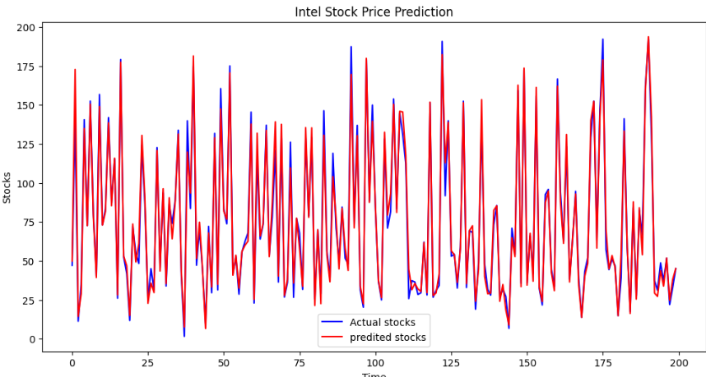
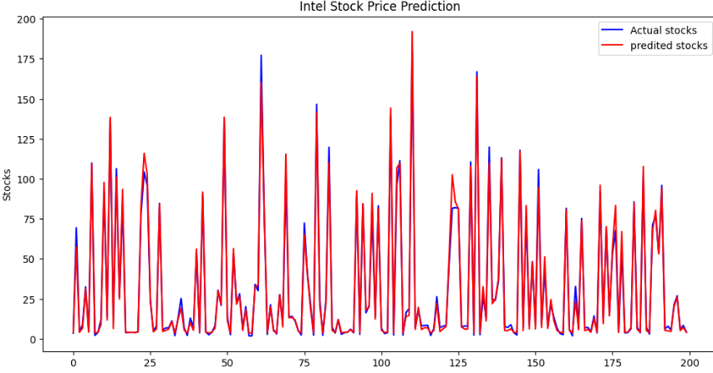

Slide 12
Impacts

Slide 13
Informed Decision-Making: Enables stakeholders to make data-driven investment decisions by predicting stock trends.
Risk Reduction: Helps in identifying potential risks and preparing mitigation strategies.
Operational Efficiency: Automates stock analysis, saving time and resources.
Enhanced Profitability: Provides timely insights to capitalize on market opportunities.
Strategic Planning: Assists businesses in long-term financial planning using predictive analytics.

Slide 14
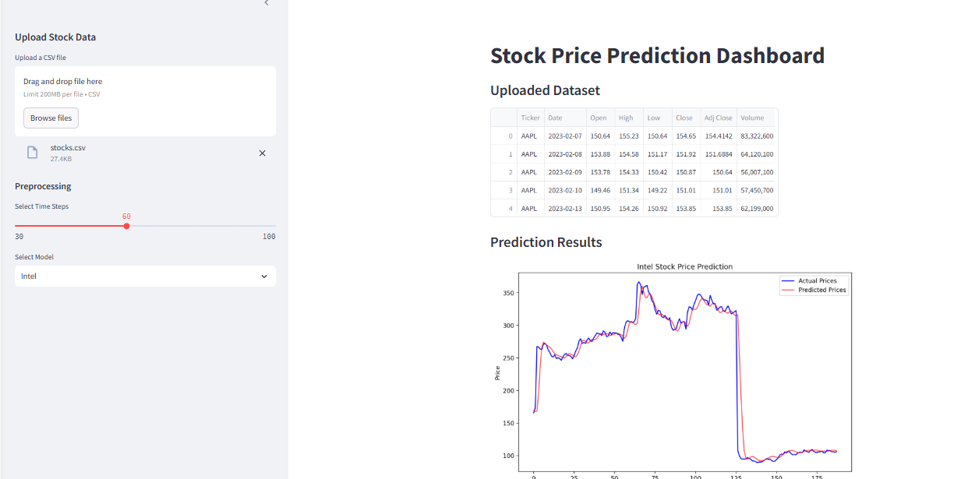
Demo

Slide 15
LINK TO GITHUB REPOSITORY :

Slide 16
THANK YOU

